Slide 1
Team-Based Learning in an Integrated Medical Sciences Curriculum
Paul G. Koles, MD
Director of Pathology Education
WSU Boonshoft School of Medicine
Used by permission of the author

Slide 2

Creation of A TBL Module
Curricular Goals
Specific Learning Objectives
Advance Assignment
Readiness Assessment Test
Application Exercise
Ample Creative Time
Partner/Mentor

Slide 3
Creation of TBL Module: 1
Curricular Goals
Specific Learning Objectives
Advance Assignment
Readiness Assessment Test
Application Exercise
Ample Creative Time
Partner/Mentor
• Mastery of basic medical science content relevant to each organ system
• Specific year 2 emphases:
--physiology
--pathology
--pharmacology
• Ability to apply integrated medical science knowledge to analyze common clinical problems

Slide 4
Creation of TBL module: 2
Curricular Goals
Specific Learning Objectives
Advance Assignment
Readiness Assessment Test
Application Exercise
Ample Creative Time
Partner/Mentor
Setting: second year neuroscience course, 8 weeks long, 30-40 faculty
Learning Objectives for Module in Neurodegenerative Diseases:
  Explain pathogenesis
  Describe characteristic gross & microscopic pathologic features
  Identify typical features observed in imaging studies
  Recognize typical clinical signs & symptoms
  List therapeutic options and mechanisms of action
  Predict prognosis for affected patients

Slide 5
Creation of TBL Module: 3
Curricular Goals
Specific Learning Objectives
Advance Assignment
Readiness Assessment Test
Application Exercise
Ample Creative Time
Partner/Mentor
Interdisciplinary (pathology & psychiatry)
Reading
  Cohen, Theory and Practice of Psychiatry, chapters 5 & 6
  Kumar et.al., Pathologic Basis of Disease, chapter 27, pp. 1385-1397
Lectures (one hour each)
  Delirium, Dementia, and Disorders of Cognitive Impairment (psychiatrist)
  Neurodegenerative Disorders (neuropathologist)

Slide 6
Creation of TBL Module: 4
Questions correlate with learning objectives
Questions focus on major content, not trivia
Questions are of appropriate difficulty (average score 70-80%)
Multiple-choice questions intentionally have single best answer
Test requires 10-20 minutes, depending on length of advance assignment
Curricular Goals
Specific Learning Objectives
Advance Assignment
Readiness Assessment Test
Application Exercise
Ample Creative Time
Partner/Mentor

Slide 7
Readiness Assessment Test: sample multiple choice question
Demyelination of lateral and anterior corticospinal tracts in the spinal cords of patients with amyotrophic lateral sclerosis results from
autoimmune-mediated destruction of myelin
atrophy of skeletal muscle fibers
defective synthesis of myelin by Schwann cells
destruction of neurons in anterior horns of spinal cord
destruction of neurons in the cortex and/or brainstem

Slide 8
Creation of TBL Module: 5
Curricular Goals
Specific Learning Objectives
Advance Assignment
Readiness Assessment Test
Application Exercise
Ample Creative Time
Partner/Mentor

Slide 9

Application Exercise
The most critical and challenging aspect of TBL
Requires careful planning to challenge even the most competent and effective teams
Scylla and Charybdis:
  Questions too easy: Can’t have spirited discussion when all teams agree on answers
  Questions too hard: Predictable frustration if groups of well-prepared students cannot arrive at the most reasonable answer because question has design flaws or requires “outside” knowledge

Slide 10
A 74-year-old man with a worried daughter
Neuroscience Team Learning Exercise 4A
David Bienenfeld, MD
Brenda Roman, MD
Paul Koles, MD
Wright State University Boonshoft School of Medicine

Slide 11
History, Physical Exam, and Mental Status Exam
See Case Protocol (handout)

Slide 12
Question 1
Which two features in this patient’s history and mental status exam reflect deficits in cognitive domains other than memory, and are therefore suggestive of dementia?
Getting lost while driving downtown and mixing up the names of grandchildren
Getting lost while driving downtown and inability to name the vice-president and governor
Getting lost while driving downtown and taking excessive time to get dressed
Mixing up the names of grandchildren and inability to name the vice-president and governor
Mixing up the names of grandchildren and taking excessive time to get dressed
Inability to name the vice-president and governor and taking excessive time to get dressed

Slide 13
Question 2
Upon completion of the history, physical, neurologic, and mental status exams, Dr. DD elects to order a limited number of laboratory tests to evaluate for possible reversible causes of cognitive impairment. Which two lab tests would be most appropriate?
Serum B6 and B12
Serum B6 and potassium
Serum B6 and free thyroxine
Serum B12 and potassium
Serum B12 and free thyroxine
Serum potassium and free thyroxine

Slide 14
Question 3
Mr. Brown’s MRI scan of the brain with contrast is illustrated on the monitors. What is the most accurate interpretation of the anatomic changes at this time?
Cerebral atrophy, diagnostic of Alzheimer disease
Cerebral atrophy, diagnostic of Pick disease
Cerebral atrophy, diagnostic of diffuse Lewy body disease
Cerebral atrophy, consistent with Alzheimer disease
Cerebral atrophy, consistent with Pick disease
Cerebral atrophy, etiology undertermined

Slide 15
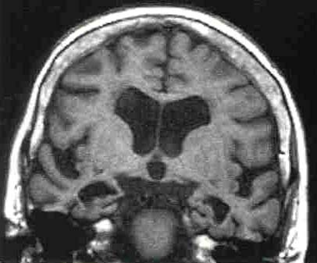
MRI scan of brain, with contrast

Slide 16
Treatment Decisions
Because Mr. Brown meets clinical criteria for dementia, and there is no evidence of vascular disease or other significant pathologic process on the MRI scan, he is given a diagnosis of “probable Alzheimer disease”.
Dr. Debonair discusses potential benefits and risks of pharmacologic therapy with Mr. Brown and his family, and they mutually agree to start drug therapy.

Slide 17
Question 4
Which drug regimen would be most appropriate for Mr. Brown at this time?
Tacrine alone
Donepizil alone
Sertraline alone
Donepezil and sertraline
Tacrine and sertraline
Donepezil and risperidone
Tacrine and risperidone

Slide 18
Question 5
When pressed by Mr. Brown’s daughter for an honest opinion about the benefits of therapy with donepezil, Dr.Debonair’s answer should be:
“We expect a mild improvement in function for 6-12 months, then a gradual decline despite taking medication.”
“We expect a mild improvement in function for 12-36 months, then a gradual decline despite taking medication.”
“We expect marked improvement in function with elimination of most cognitive deficits, but these benefits will only last 3-6 months, followed by a gradual decline despite taking medication.”
“We expect marked improvement in function with elimination of most cognitive deficits, but these benefits will only last 6-12 months, followed by a gradual decline despite taking medication.”
“We expect no definite improvement in function, but the progression of his disease will be delayed by 1-2 years.”

Slide 19
The rest of the story
Mr. Brown responded to donepezil therapy with somewhat improved short-term memory, but the benefits lasted only about a year. Over the next 5 years, he became progressively worse, getting lost while walking in his own neighborhood several times. At age 80, his wife and family elected to place him in a facility specializing in long-term care of Alzheimer patients, with frequent home visits. He developed progressive congestive heart failure secondary to hypertension, and died at age 82.
Mr. Brown’s well-educated daughter, after consultation with Dr. DD, requested postmortem neuropathologic examination for diagnosis and information to guide personal genetic counseling.

Slide 20
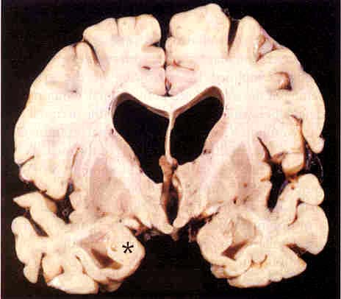
Q6) A coronal slice of Mr. Brown’s brain is shown on the monitors. Histologic sections from which circled area would be most likely to demonstrate all 5 characteristic features of AD? (neuritic plaques, neurofibrillary tangles, amyloid angiopathy, granulovacuolar degeneration, and Hirano bodies)
*
*
*
*
*
Red circle B) black circle C) blue circle
D) green circle E) white circle F) yellow circle

Slide 21
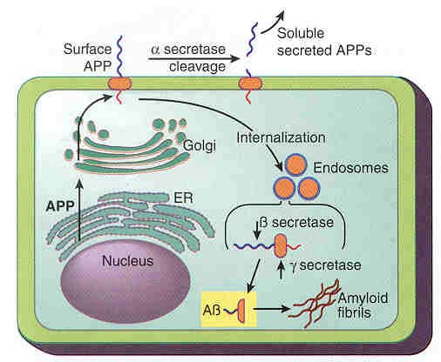
Pathogenesis
This cartoon (fig. 30-30, Robbins Pathologic Basis of Disease, 6th ed, WB Saunders, 1999) illustrates current concepts of how cerebral neurons process amyloid precursor protein (APP).

Slide 22
Q7) Assuming these concepts are correct, which combination of enzyme activities would be most beneficial for preventing Alzheimer disease?
Answer | Alpha-secretase | Beta-secretase | Gamma-secretase
A | increased | increased | increased
B | decreased | increased | increased
C | increased | decreased | Increased
D | decreased | decreased | decreased
E | increased | decreased | decreased
F | decreased | decreased | increased
 | “increased”= enhanced activity |  | “decreased” = diminished activity

Slide 23
Genetic counseling
Mr. Brown’s daughter requests genetic testing to determine her genotype for apolipoprotein E. Her peripheral venous blood is drawn and lymphocytes are cultured for cytogenetic and DNA analysis. Dr. DD is forced to review his recent journals for correct interpretation of these results, and fortunately he finds a good review article before her results are back.
Q8) Which genotype for apolipoprotein E on chromosome 19 would put his daughter at greatest risk for the development of Alzheimer disease?
Є2/Є2 D) Є3/Є4
Є2/Є3 E) Є4/Є4
Є3/Є3

Slide 24
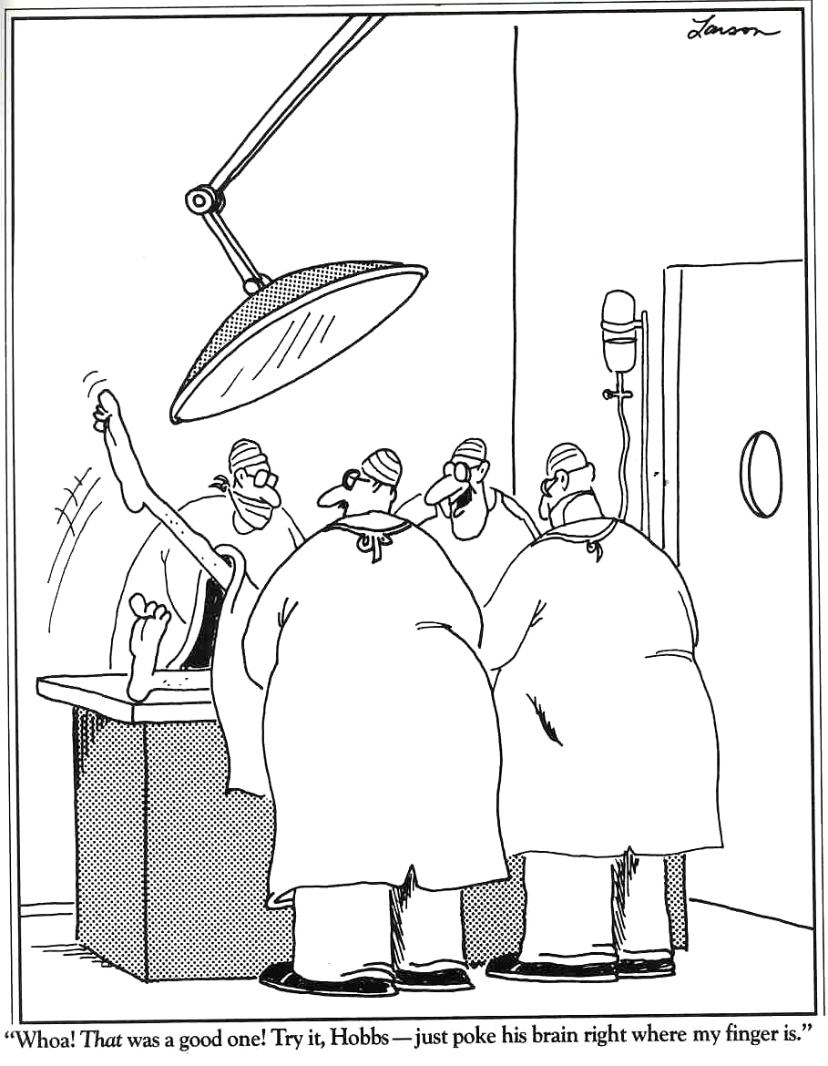
Neuro-surgeons at work

Slide 25
Creating TBL module: 6
Curricular Goals
Specific Learning Objectives
Advance Assignment
Readiness Assessment Test
Application Exercise
Ample Creative Time
Partner/Mentor
Ample time needed BEFORE the live TBL module
Creation of New TBL module from scratch: 10-25 hours
Lion’s share of creative time: designing a challenging application exercise
Field testing of module is the best criterion of effectiveness

Slide 26

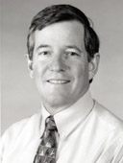
Creating TBL Module: 7
Curricular Goals
Specific Learning Objectives
Advance Assignment
Readiness Assessment Test
Application Exercise
Ample Creative Time
Partner/Mentor
Stuart Nelson, PhD, Assoc. Professor of Pathology, WSUSOM
Dean Parmelee, MD, Assoc. Dean for Academic Affairs, WSUSOM

